Slide 1
Data And Data Flow In React
CHAITANYA SAHU
22H51A0575

Slide 2
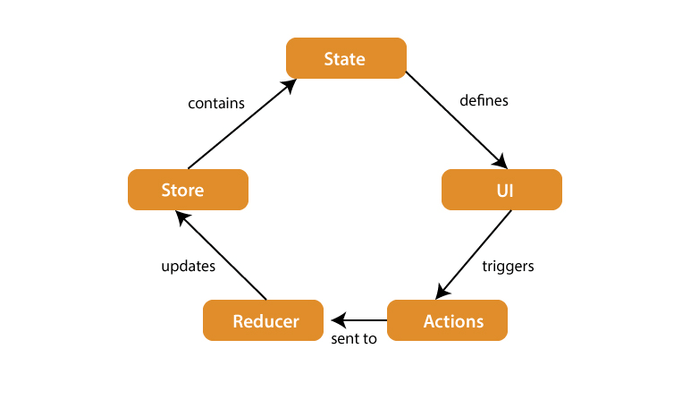

Introduction to Data in React
React is a JavaScript library for building user interfaces, focusing on a component-based architecture.
Data in React is primarily managed through state and props, which show how components render and behave.
React follows a unidirectional data flow, meaning that data flows in a single direction through the components.
This helps in maintaining a predictable state and making it easier to understand how changes affect the application.
Notes:
Image source: https://onaircode.com/top-javascript-frameworks/react-a-javascript-library-for-building-user-interfaces/

Slide 3

React Components and state management
Components are the building blocks of React applications, encapsulating logic and UI.
Each component can maintain its own state or receive data through props from parent components.
A state in React is a special object that represents the current state of a component.
State is used to manage dynamic data and to trigger re-rendering of components when the state changes
Notes:
Image source: https://www.vrogue.co/post/what-is-components-in-react-js

Slide 4
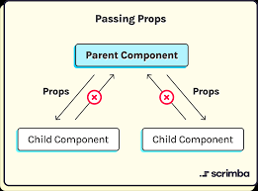
Props in React
Props are short for properties and allow data to be passed from parent components to child components.
They enable the creation of dynamic and reusable components that can behave differently based on input data.
Used to pass data from a parent component to a child component.
Props are immutable within the child component (cannot be modified).
Example: Passing data from a parent App component to a child UserProfile component.
Notes:
Image source: https://www.linkedin.com/pulse/understanding-react-props-beginners-guide-passing-data-aubair-akif

Slide 5
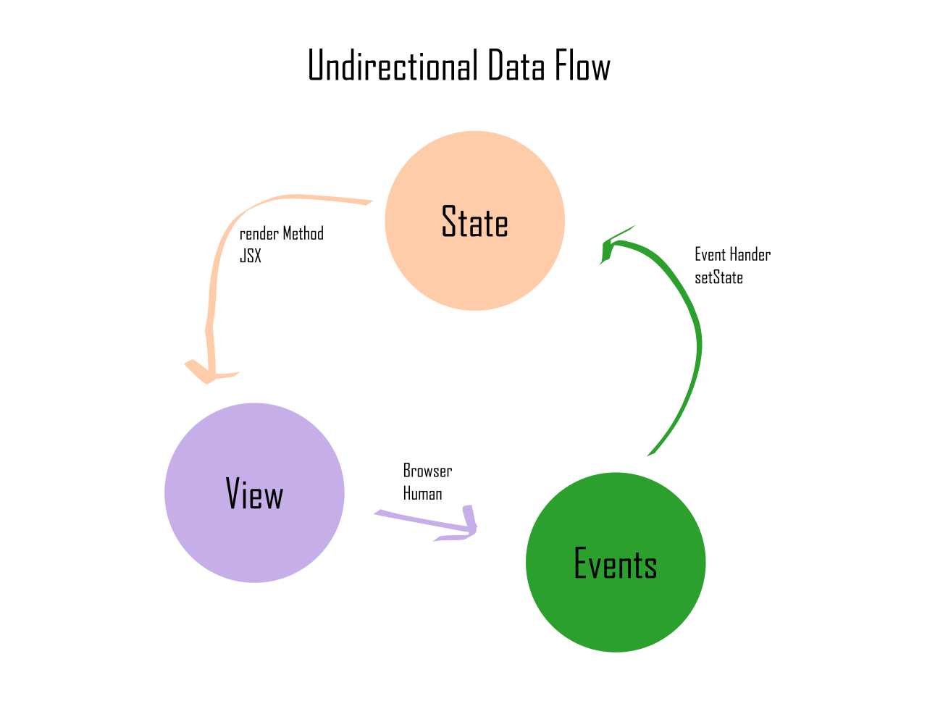
Unidirectional Data Flow
React enforces a unidirectional data flow, meaning data flows in one direction: from parent to child.
This makes it easier to understand how data changes affect the UI, leading to more predictable behavior.
Unidirectional flow simplifies debugging and enhances maintainability in complex applications.
Notes:
Image source: https://www.exploringreact.com/2020/11/18/react-and-unidirectional-data-flow-understand-this-and-your-life-will-be-a-lot-easier-as-a-react-developer/

Slide 6
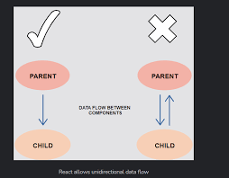
Parent to Child
Data is passed from parent components to child components through props.
The parent component owns the state, and it passes down relevant data to its child components as props.
Props (short for “properties”) in React are a mechanism for passing data from a parent component to its child component as a set of read-only attributes.
Notes:
Image source: https://www.exploringreact.com/2020/11/18/react-and-unidirectional-data-flow-understand-this-and-your-life-will-be-a-lot-easier-as-a-react-developer/

Slide 7
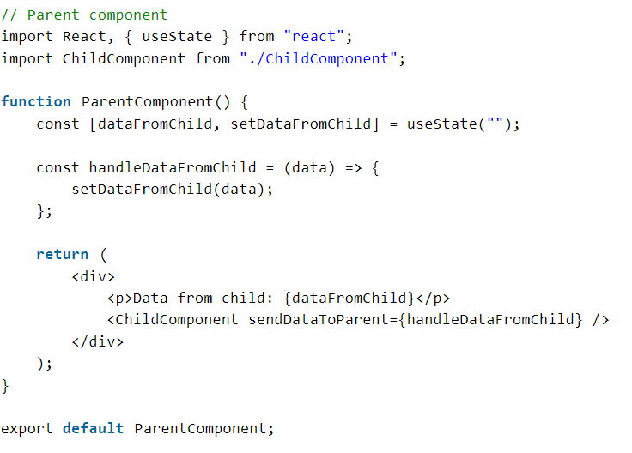
Child to Parent
To communicate from child to parent, the parent can pass down a callback function as a prop to the child.
The child can then invoke this function to send data back to the parent.
Notes:
Image source: https://www.exploringreact.com/2020/11/18/react-and-unidirectional-data-flow-understand-this-and-your-life-will-be-a-lot-easier-as-a-react-developer/

Slide 8
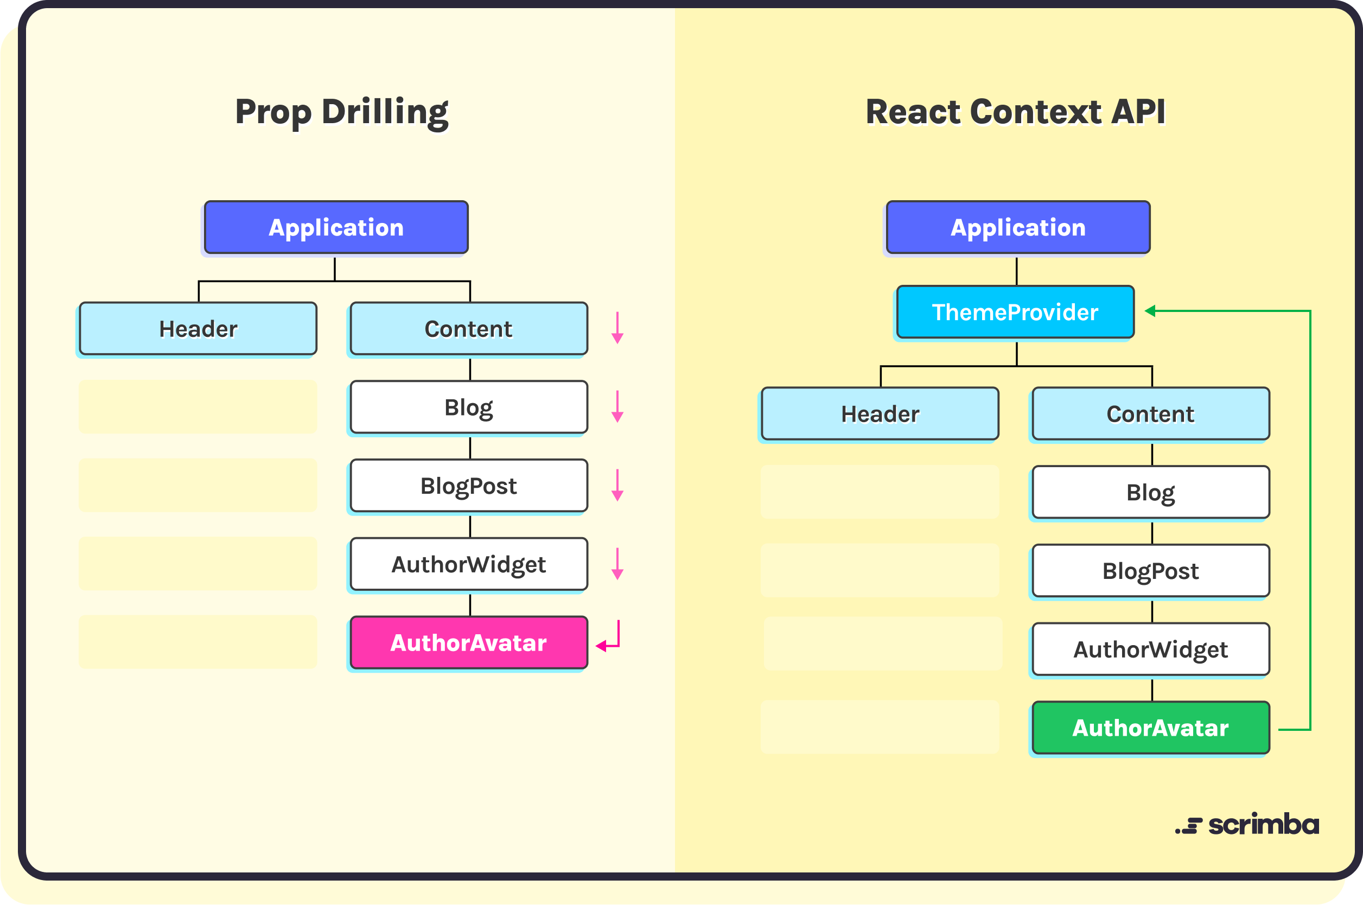
Context API
The Context API is a way to share data across components without passing props manually at every level.
It is useful for managing global data, such as themes or user authentication, that many components may need access to.
Notes:
Image source: https://scrimba.com/articles/react-context-api/

Slide 9
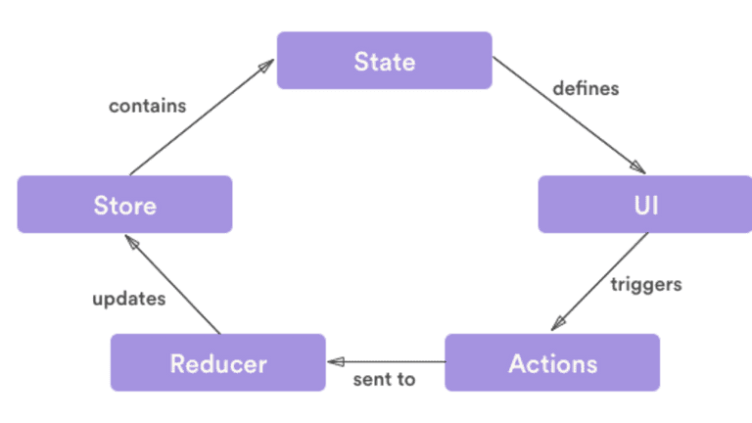
Redux for State Management
Redux is a popular library for managing state in larger React applications, providing a centralized store.
It allows components to subscribe to specific slices of the state and dispatch actions to update that state.
Redux promotes predictable state updates, making it easier to manage complex interactions in the application.
Notes:
Image source: https://www.loginradius.com/blog/engineering/react-state-management/

Slide 10
Conclusion
Data and data flow are foundational concepts in React that influence how applications are structured and function.
React’s unidirectional data flow model simplifies debugging and ensures better control over component behavior.
State and props help manage data within the app, and advanced tools like the Context API and Redux make complex data management easier
Notes:
Image source: https://www.ewsolutions.com/foundational-concepts-modernizing-data-analytics-platforms/

Slide 11
THANK YOU
Notes:
Image source: https://www.ewsolutions.com/foundational-concepts-modernizing-data-analytics-platforms/

